Slide 1
Spring PSSC meeting #5 May 14, 2026
Jenna Dyer - Chair
Jeremy Bosse – Vice Chair
Jessica Smith (teacher rep.) - Secretary
Hazel Chandler
Setira Williams
Kathryn Mann
Krista Sockabasin
Sophia Rodriguez Gallagher DEC rep.
Claudine Grant (principal)
DEC and Principal are non members

Slide 2
AGENDA
Call to Order
Approval of the Agenda
Approval of the Minutes from Previous Meeting (Feb. 4, 2026)
Business Arising from the Minutes
Standing Items
Principal’s Report ; Claudine
Staff/student updates
Long Term Recommendation 2.1 – Middle Level Learners
SIP update
Projects and Events - Jessica
DEC report - Sophia
Home and School update-Jenna
New Business:
Breakfast program
Lunch Program for Sept. 2026
Date of Next Meeting: to be determined
Adjournment:

Slide 3
Approval of minutes from Feb. 4, 2026

Slide 4
PAMS – staffing update
Custodian change – Peter Jensen has moved to SVHS (May 11 – Oct. 2nd)
FN Academic Support Worker – Crispin Gallant

Slide 5
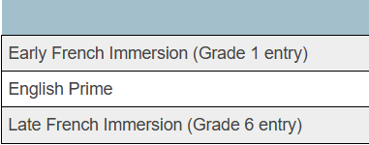
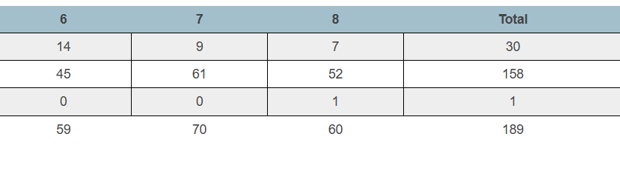
Principal’s report – 189 students no change PAMS student enrollment by program
Net change of zero
Decrease of 1 student in grade 7
Increase of 1 student in grade 6

Slide 6
Long term recommendation 2.1 - Revitalizing Middle Block Philosophy
Purpose:
To provide schools with practical tools and resources that support early adolescents
PAMS Focus Areas:
Relationship – learner to learner

Slide 7
Staffing 2026-27
15.0 FTE (Full Time Positions)
1 AST (academic support worker)
1.4 School resource teacher
0.6 School Counsellor
1.2 administration
Enrollment 173 students

Slide 8
Update
Building Cooperation
Relaunch the 7 expectations
Teach and practice in classroom connection
Positive reinforcement
Build in incentives – BINGO
Focus on stay in assigned seat / raise your hand to speak
April

Slide 9
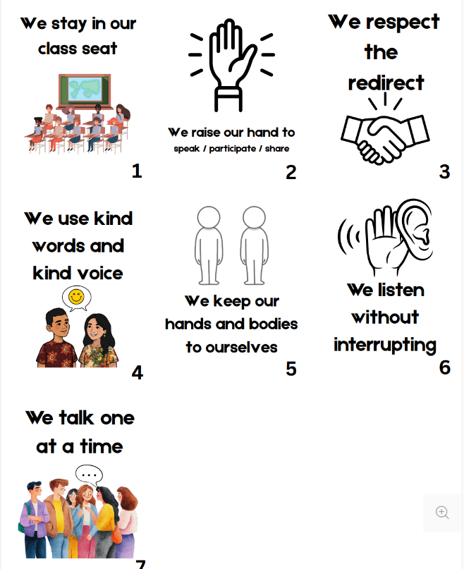
7 expectations

Slide 10
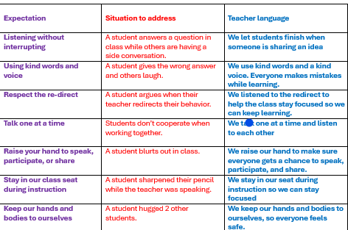
Common language

Slide 11
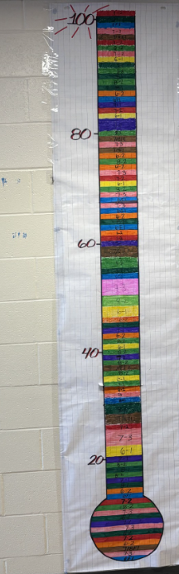
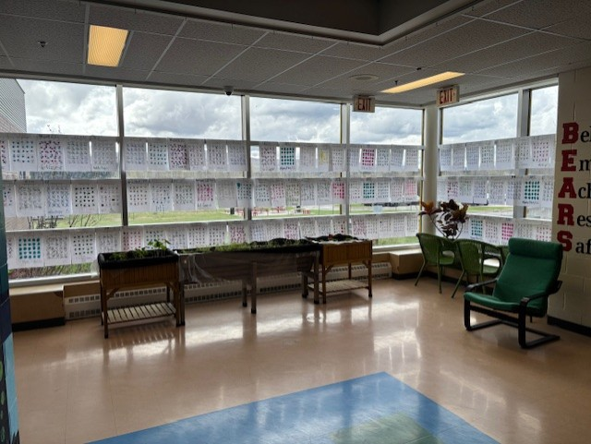

Slide 12
Update
Positive reinforcement
“Caught You” cards as incentives
Focus on Speaking one at a time/listening
Visual chart
May

Slide 13
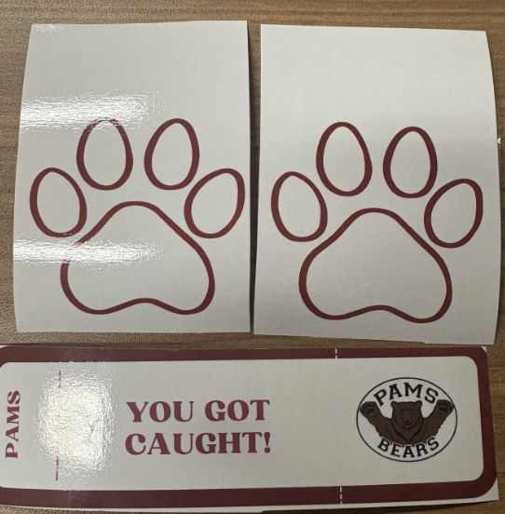
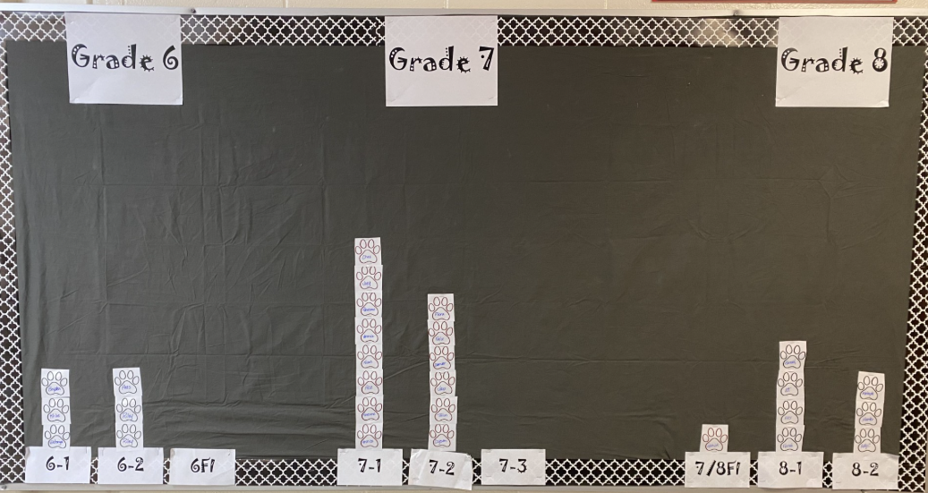

Slide 14
Update
“you got caught” focus
Hands off/bodies off
Use kind words and kind voice
Focus and Plan for Sept. 2026
Student Feedback – small group
Staff Feedback
Restorative circles/strategies for group work
June

Slide 15
School Improvement Goal
By June 2026, PAMS will improve behavioral engagement by creating a student-centered learning environment. 100% of teachers will intentionally incorporate the three learning styles in classroom instruction. We will tailor instruction to meet the learning styles of students while incorporating choice, voice, and relevance to content areas.

Slide 16
Progress monitoring
Year end success will show a 10% increase in positive responses to questions 4,6, and 12 of the 2024 provincial student survey.
Progress monitoring will in-house student surveys, administration walkthroughs, and teacher self-assessments.

Slide 17
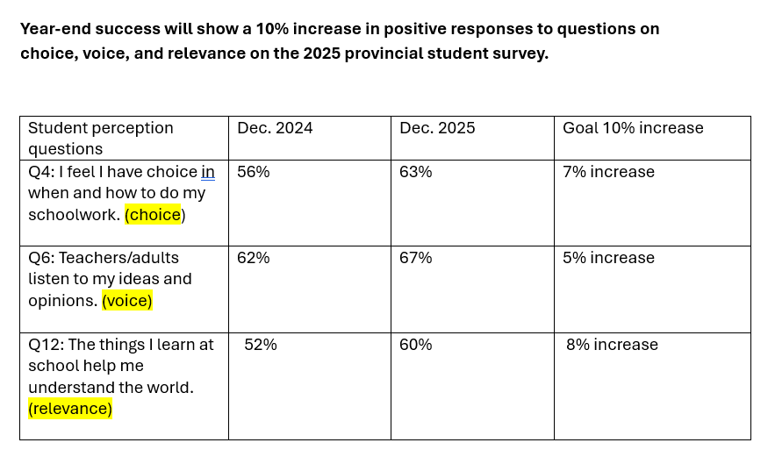
Progress monitoring – 2025 Student survey

Slide 18
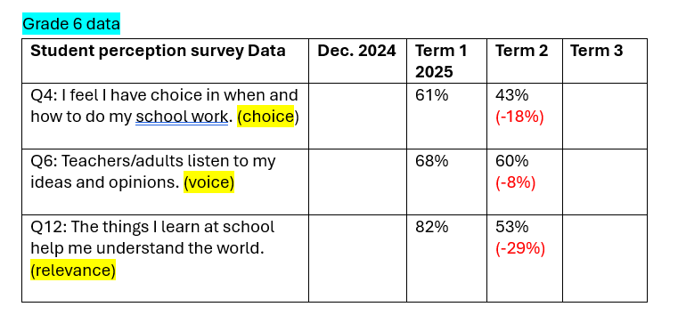
Progress monitoring – Grade 6

Slide 19
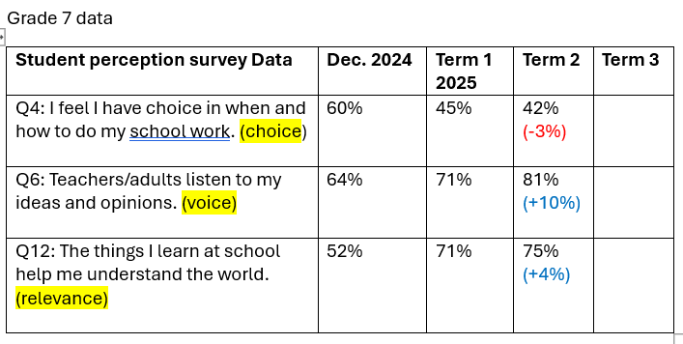
Progress monitoring – Grade 7

Slide 20
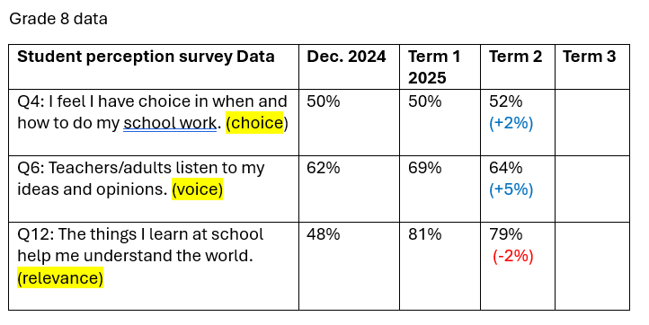
Progress monitoring – Grade 8

Slide 21
Special events and Projects

Slide 22
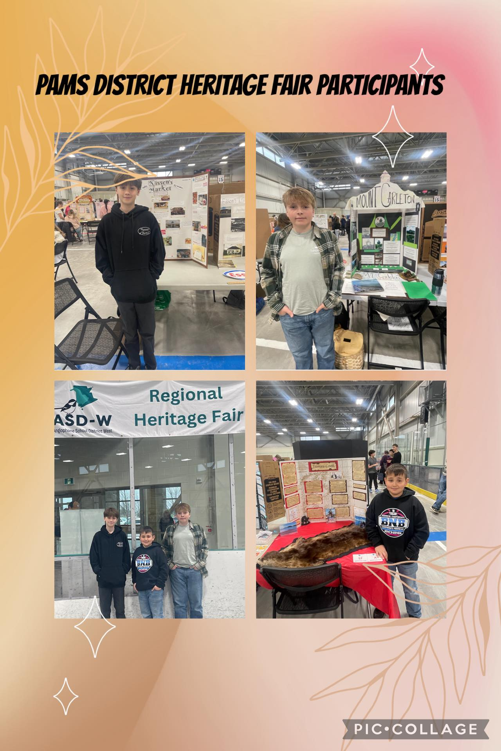

PAMS Heritage Hair

Slide 23
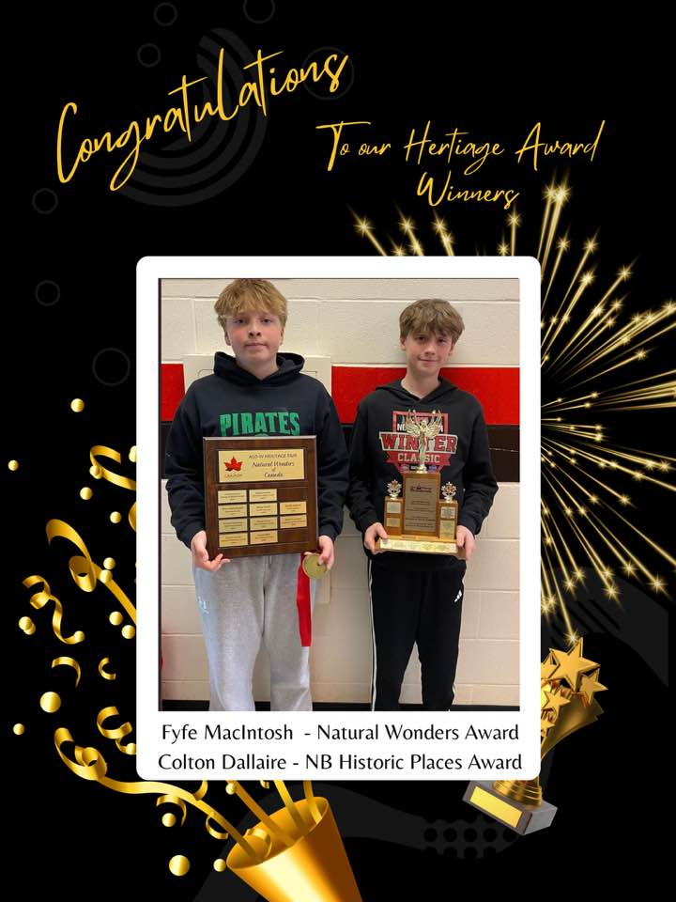
District Heritage Hair

Slide 24
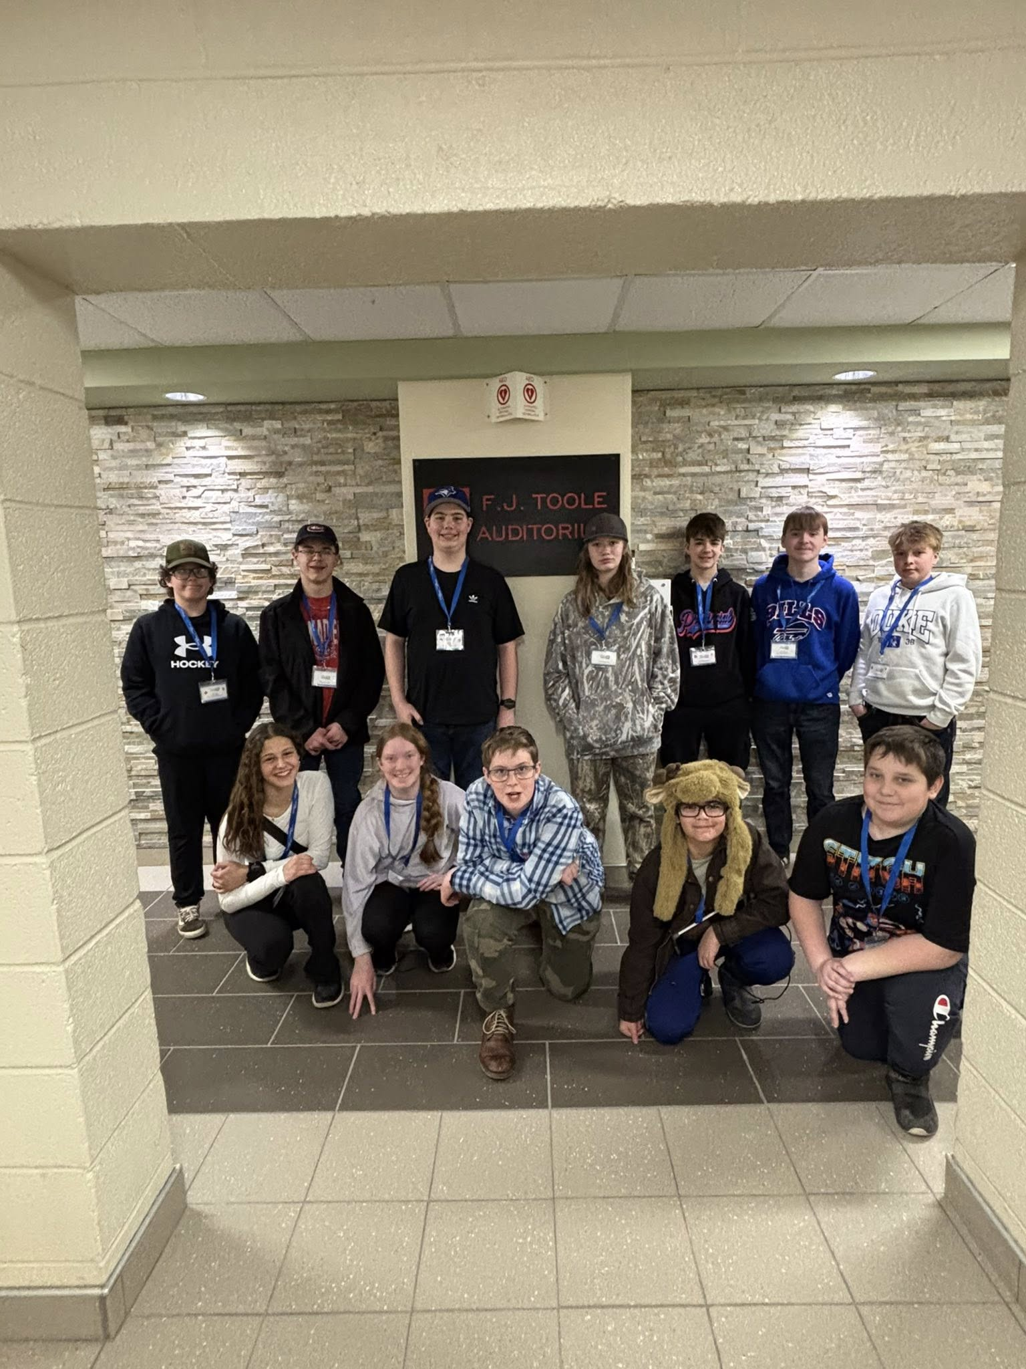
Let’s talk science

Slide 25
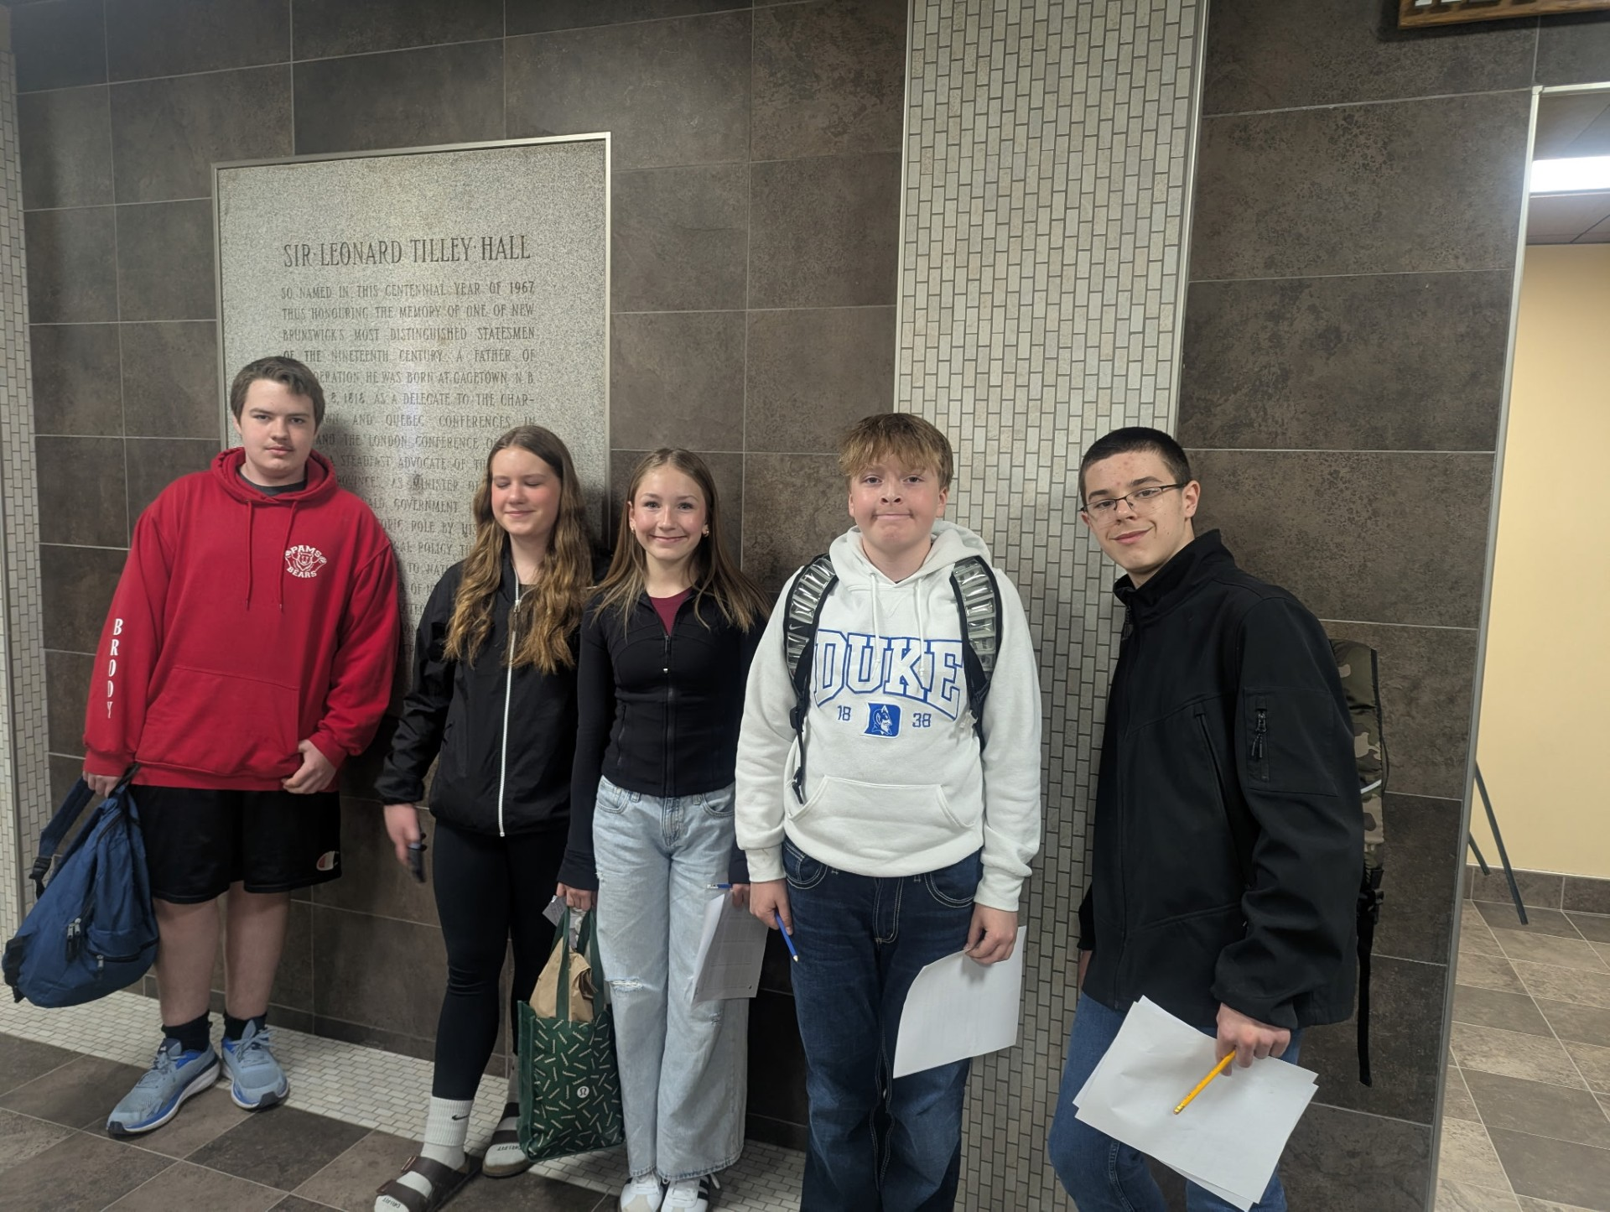
UNB Math Competition Grade 7

Slide 26
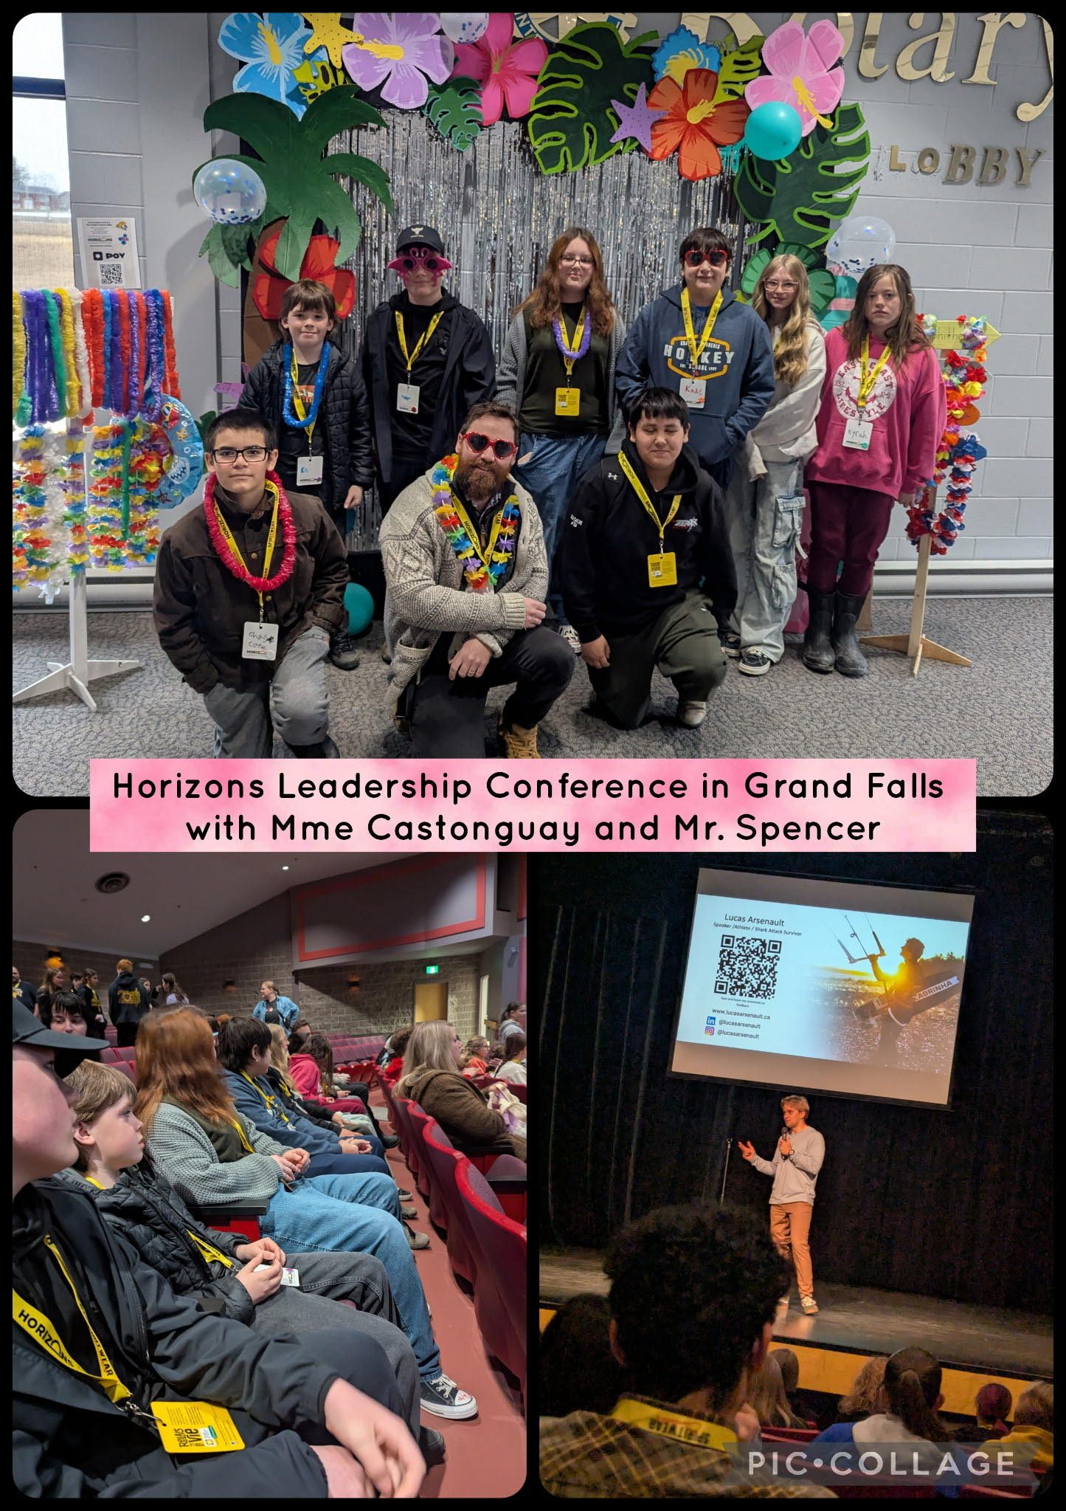
Horizon Leadership Conference

Slide 27
Transitions grade 5 – tentative
Feb. 18th PBIS Sliding Party/ Fire/ Hot Chocolate
Feb 26 Chocolate bar Bingo
Mar. 12 AES & Mah-Sos visit for welcome activity.
Apr. 8th PAMS staff visits Mah-Sos and AES for Q and A
Apr. 30 Mah-Sos and AES visit PAMS for assembly and lunch
May 12 Gr 5 Students at PAMS for station activities and get to know you time
May 27 Mah-Sos join PAMS grade6
June 9th - Parents open house

Slide 28
DEC report -

Slide 29
Home and school -

Slide 30
Provincial lunch program sharing information
Start date – September 2026
options
Subsidized price $4.00
Fully subsidized
Chartwell’s will be our service provider
Main meal
Vegan option
On-line ordering process where parents indicate their desired option

Slide 31
Breakfast program
Fully run by volunteers
Prepared in culinary tech. room
Hot breakfast 5 days a week
50+ students participate daily
Volunteers needed for Fall

