Slide 1
Winter PSSC meeting #4 March 18, 2026
Jenna Dyer - Chair
Jeremy Bosse – Vice Chair
Jessica Smith (teacher rep.) - Secretary
Hazel Chandler
Setira Williams
Kathryn Mann
Krista Sockabasin
Sophia Rodriguez Gallagher DEC rep.
Claudine Grant (principal)
DEC and Principal are non members

Slide 2
AGENDA
Call to Order
Approval of the Agenda
Approval of the Minutes from Previous Meeting (Feb. 4, 2026)
Business Arising from the Minutes
Standing items
Principal’s Report ; Claudine
    Staff/student updates
    Long Term Recommendation 2.1 – Middle Level Learners
    SIP update
Projects and Events – Jessica
DEC report - Sophia
Home and School update-Jenna
New business
Report cards / parent teacher
Provincial lunch program sharing information
Breakfast program
Canada Feed the Children
2025-26 projections
Date of Next Meeting: to be determined
Adjournment:

Slide 3
Approval of minutes from Feb. 4, 2026

Slide 4
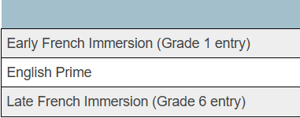
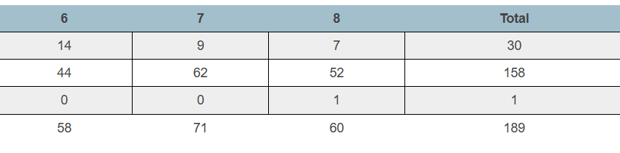
Principal’s report – 189 students - new
PAMS student enrollment by program
Net change of zero
Decrease of 1 student / increase of 1 student in grade 6
Decrease of 1 student in grade 7
Increase of 1 student in grade 8

Slide 5
PAMS – staffing update
BIM (behavior intervention mentor) –
Courtney Hemphill
EA change – Jayleigh Jamer joined the team

Slide 6
Long term recommendation
2.1 - Revitalizing Middle Block Philosophy
Purpose:
To provide schools with practical tools and resources that support early adolescents
PAMS Focus Areas:
  Relationship – learner to learner

Slide 7
Our
Next
Steps
Phase 1 Focus: Building Cooperation
  Define Cooperation (Shared Understanding)
  Develop a clear, shared definition
  Focus on observable behaviours
  Use common language for students, staff, and families
February to June

Slide 8
What we heard from staff
Key Themes
Students need stronger cooperation micro-skills (listening, tone, patience, problem solving).
Kindness, empathy, and belonging are areas where students need support.
Students struggle to work with people outside their friend group.
Listening and turn-taking are inconsistent in group discussions.
Teachers want common language and consistent responses across classrooms.
Staff emphasized the importance of explicitly teaching and modeling these skills, not assuming students already have them.

Slide 9
What we heard from staff
What Staff Said
“This is an essential life skill.”
“Many students struggle with empathy and patience. It impacts relationships and learning.”
“We need common language so students hear the same message from every teacher.”
“Students often argue about group pairings or refuse to work with people who aren’t their friends.”

Slide 10
What we heard from students
Key Themes
Students want classrooms where people listen and don’t interrupt.
They want respectful communication during discussions.
Students want to feel included and not left out when working in groups.
Some students said group work can be difficult because of conflicts, interruptions, or lack of cooperation.
Students suggested simple norms like one person speaking at a time and respecting others’ ideas.

Slide 11
What we heard from students
“People should listen to each other and not interrupt.”
“No laughing at other people’s ideas.”
“Everyone should get a chance to speak.”
“Sometimes people get left out when groups are chosen.”

Slide 12
Our
Next
Steps
Email to Parents
  March 24th – staff meeting regroup
  March 30th – launch
  April 2nd – staff reflection

Slide 13
School Improvement Goal
By June 2026, PAMS will improve behavioral engagement by creating a student-centered learning environment. 100% of teachers will intentionally incorporate the three learning styles in classroom instruction. We will tailor instruction to meet the learning styles of students while incorporating choice, voice, and relevance to content areas.

Slide 14
Progress monitoring
Year end success will show a 10% increase in positive responses to questions 4,6, and 12 of the 2024 provincial student survey.
Progress monitoring will in-house student surveys, administration walkthroughs, and teacher self-assessments.

Slide 15
Progress monitoring
Subject teams meet formally to discuss strategies to meet learning styles.
Grade level teams meet monthly to share success and challenges
Student survey will take place week of April 7th to assess progress on key indicators of success.

Slide 16
Special events and Projects
Land based learning - an opportunity for Wolastoqey students to learn from elders and community members – Negqotkuk, March 18
“Power-Up 2026” – an event for 2SLGBTQIA+ middle school students and allies - Woodstock, March 19th
“Sugar Moon” sugar bush visit and breakfast/lunch – April 1st

Slide 17


Bingo Night

Slide 18
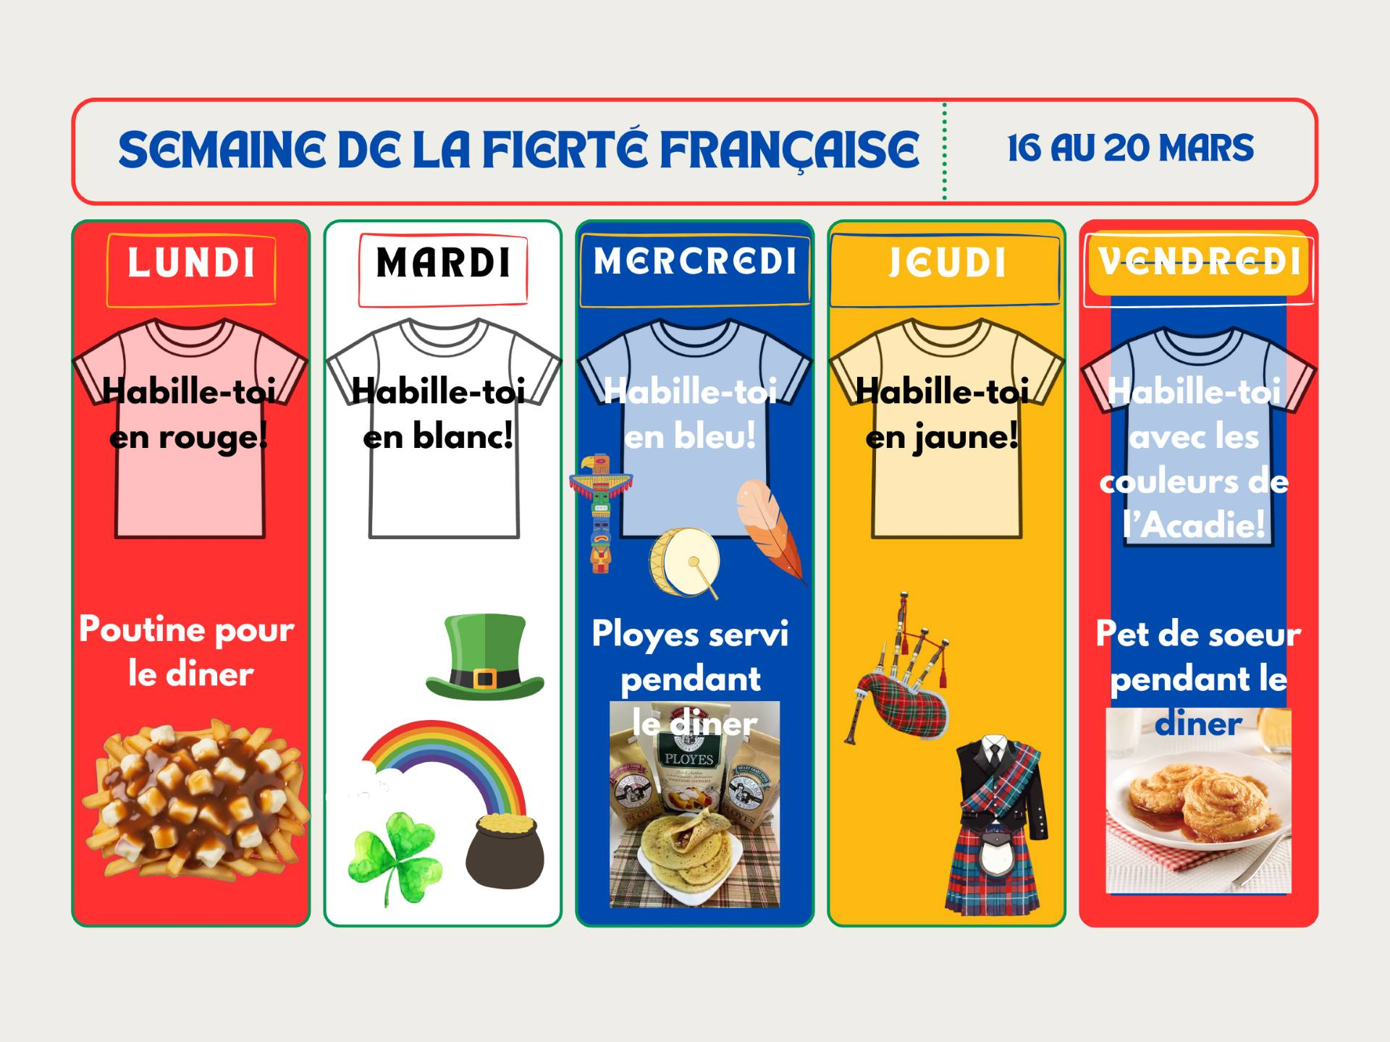
French pride week

Slide 19
Transitions grade 5 – tentative
Feb. 18th PBIS Sliding Party/ Fire/ Hot Chocolate
Feb 26 Chocolate bar Bingo
Mar. 12 AES & Mah-Sos visit for welcome activity.
Apr. 8th PAMS staff visits Mah-Sos and AES for Q and A
Apr. 30 Mah-Sos and AES visit PAMS for assembly and lunch
May 12 Gr 5 Students at PAMS for station activities and get to know you time
May 27 Mah-Sos join PAMS grade6
June - Parents open house

Slide 20
DEC report -

Slide 21
Home and school -

Slide 22
Report cards / parent teacher
-
Report cards go home – March 30th
Parent teacher conference
April 3rd 3;30 – 7:30 am
April 4th 8:15 – 11:45am
Conference are held
    In person
    TEAMS
    Telephone
Link to book will be emailed on March 26th

Slide 23
Provincial lunch program sharing information
Start date – September 2026
3 options
Full price
Subsidized price
Free
Chartwell’s will be our service provider
Main meal
Vegan option

Slide 24
Breakfast program
4 new volunteers
Hot breakfast 5 days a week
40+ students participate daily
District is supporting with equipment as needed

Slide 25
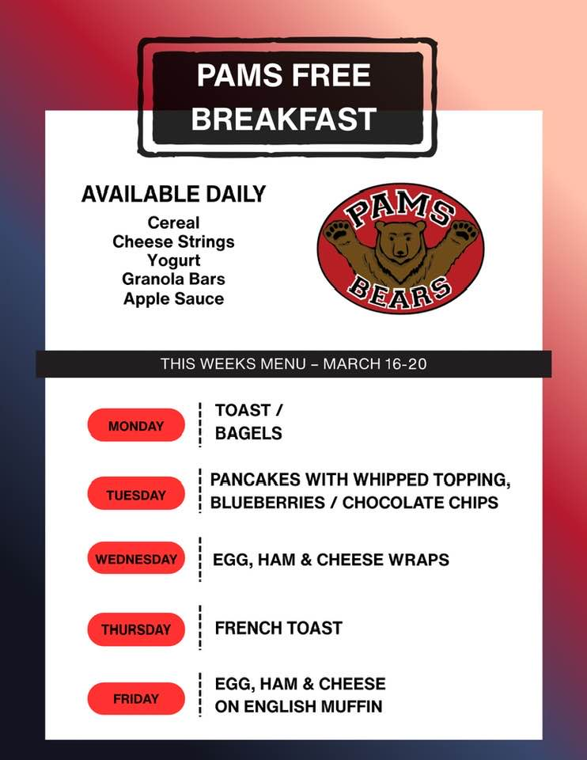

Slide 26
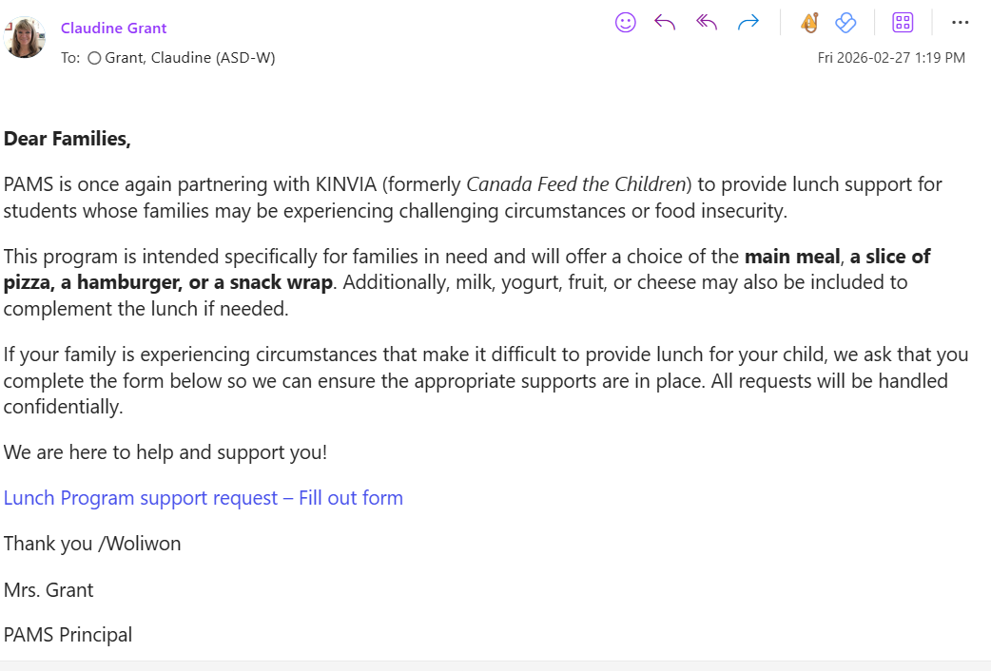
Canada feed the children -
Lunch Program support request – Fill out form

Slide 27
-
2025-26 projections
Initial student enrollment numbers are due March 23rd

