Slide 1
Winter PSSC meeting #3 Feb. 4, 2026
Jenna Dyer - Chair
Jeremy Bosse – Vice Chair
Jessica Smith (teacher rep.) - Secretary
Setira Williams
Kathryn Mann
Krista Sockabasin
Sophia Rodriguez Gallagher DEC rep.
Claudine Grant (principal)
DEC and Principal are non members

Slide 2
AGENDA
Call to Order:
Approval of the Agenda:
Approval of the Minutes from Previous
Meeting (December 2025)
Business Arising from the Minutes:
Declaration signing
Standing items
  Principal’s report - Claudine
  Staff/student update
  Long term recommendation – Middle school
  SIP update
  Projects and events - Jessica
  DEC report - Sophia
  Home and School update – Jenna
New Business:
Budget – Jenna
Breakfast program – Claudine
Correspondence:
Closing Comments:
Date of Next Meetings:

Slide 3
Meeting norms
Begin and end meetings on time,
Turn off cell phones and other electronic devices,
Stick to the agenda, keeping on track and on topic,
Address the Chair one at a time,
Limit the number of times a person speaks on an issue,
Show empathy, patience, understanding, respect & cooperate with others,
Offer solutions,

Slide 4
Approval of minutes from Dec. 8th , 2025

Slide 5
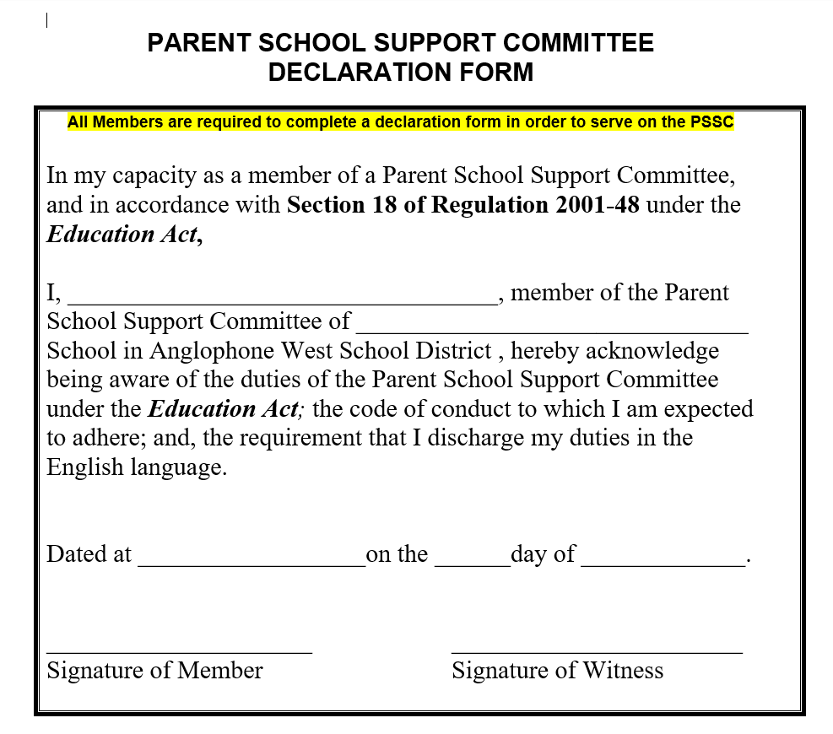
Business from Minutes :
Declaration form

Slide 6
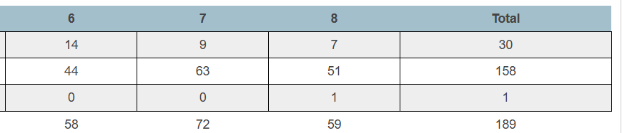
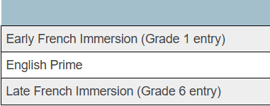
Principal’s report – 189 students
PAMS student enrollment by program
Overall Increase in total enrollment by 2 students
Increase of 2 students in grade 6
Decrease of 1 student in grade 7
Increase of 1 student in grade 8

Slide 7
PAMS – staffing update
BIM (behavior intervention mentor) – position closed on Dec. 19th , EECD reviewing applications
Kim Michaud’s FI position replaced by
Kim Castonguay – 6FI Homeroom FILA/ Social studies
Chantal Gallant–PIF
Kayla Oakes – 7.3 Homeroom / science/music

Slide 8
Long term recommendation
2.1 - Revitalizing Middle Block Philosophy
Purpose:
To provide schools with practical tools and resources that support early adolescents
PAMS Focus Areas:
  Relationship – learner to learner

Slide 9
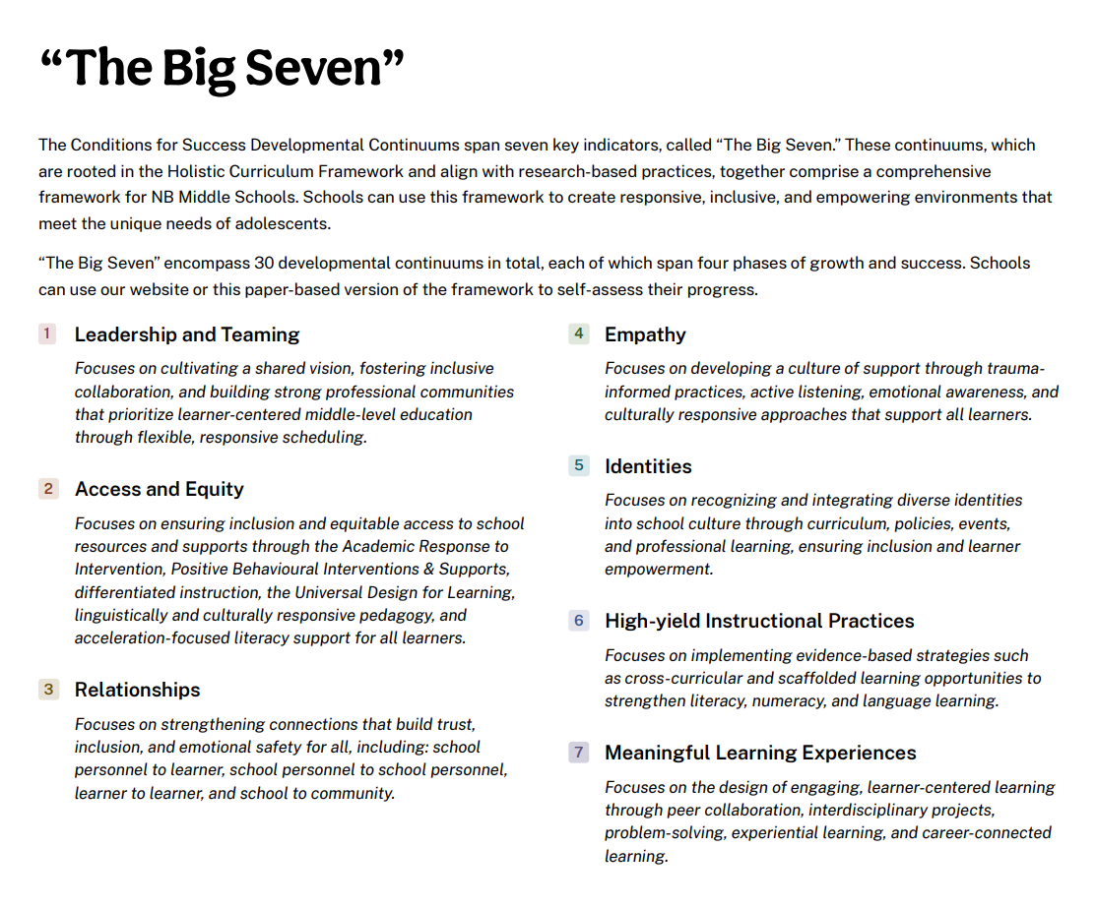

Slide 10
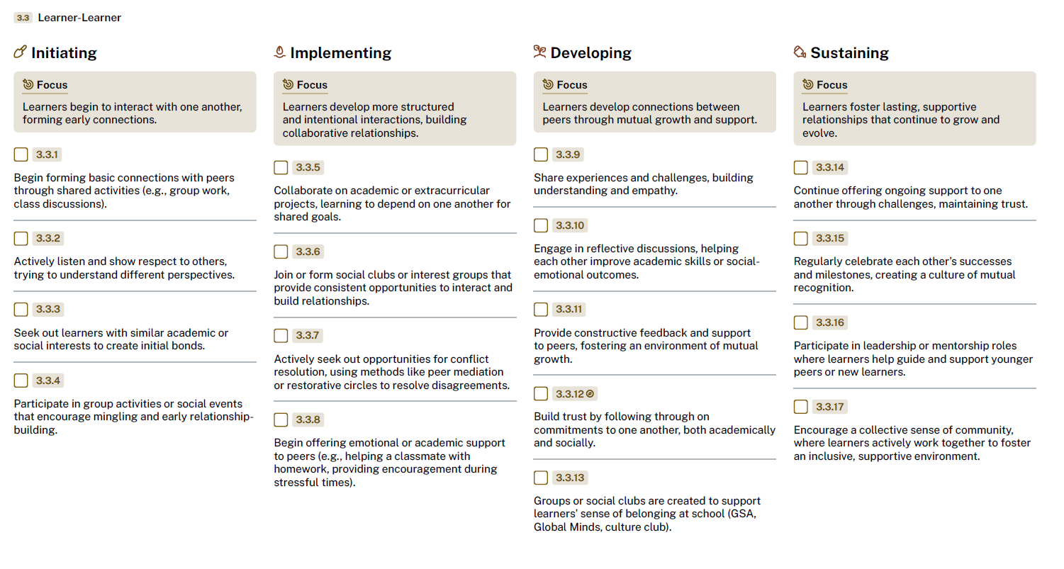

Slide 11
Our Goal:
Learners will develop the skills, talents, and abilities to work cooperatively in any setting.
Students will:
Form basic connections
Actively listen to learn different perspectives
Make connections with people who have similar interests
Participate in group activities that lead to positive behaviour
These bulleted goals are from the initiating phase of the continuum

Slide 12
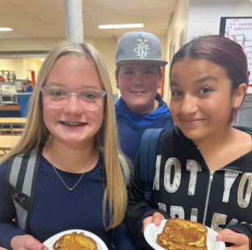
Our First Step
Meet with students to gain their perspective

Slide 13
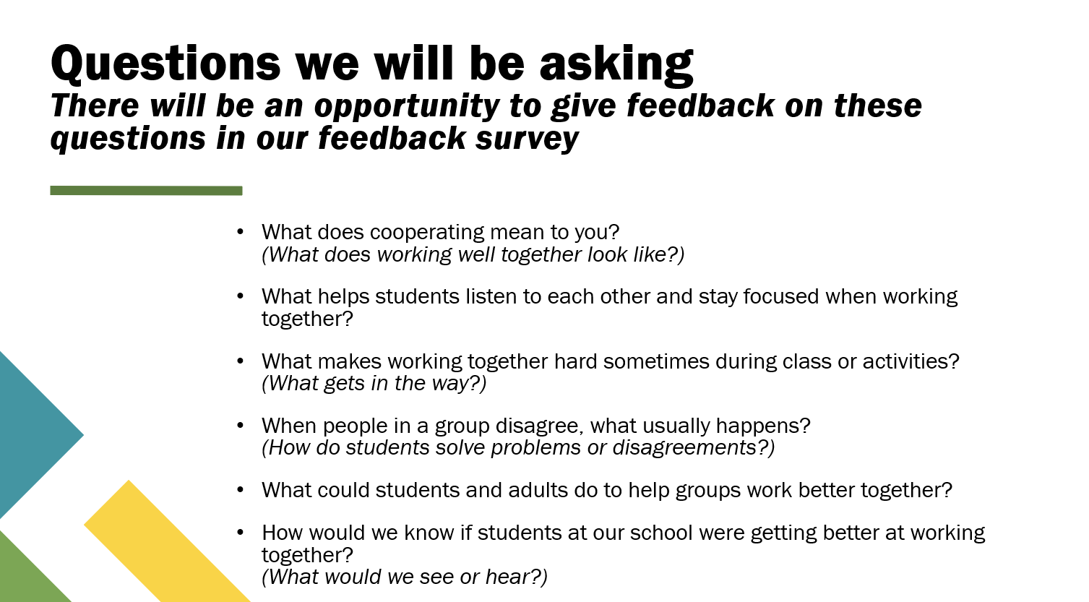

Slide 14
Our
Next
Steps
Phase 1 Focus: Building Cooperation
  Define Cooperation (Shared Understanding)
  Develop a clear, shared definition
  Focus on observable behaviours
  Use common language for students, staff, and families
February to June

Slide 15
Our
Next
Steps
Align Adult Language & Modeling
Model consistent language for cooperation
Use scripts for things like (for example):
  Disagreement, Turn-taking, Participation
  Connecting with families
Name and reinforce cooperative behaviours
Phase 1 Focus: Building Cooperation
  Define Cooperation (Shared Understanding)
  Develop a clear, shared definition
  Focus on observable behaviours
  Use common language for students, staff, and families
February to June

Slide 16


School improvement Plan GOAL
GOAL : By June 2026, Perth Andover Middle School will improve behavioral engagement by creating a student-centered learning environment. 100% of teachers will intentionally incorporate the three learning styles in classroom instruction.

Slide 17
School Improvement Goal
By June 2026, PAMS will improve behavioral engagement by creating a student-centered learning environment. 100% of teachers will intentionally incorporate the three learning styles in classroom instruction. We will tailor instruction to meet the learning styles of students while incorporating choice, voice, and relevance to content areas.

Slide 18
Progress monitoring
Year end success will show a 10% increase in positive responses to questions 4,6, and 12 of the 2024 provincial student survey.
Progress monitoring will in-house student surveys, administration walkthroughs, and teacher self-assessments.

Slide 19
Indicators of success will include :
Increase in Engagement scores on Provincial Student Survey (December) and PAMS Survey Scores (December/March/June)
  Q12: “What I learn helps me understand the world.”
  Q4: “I have choice in my schoolwork.”
  Q6: “My teachers listen to my ideas.”
Increase Teacher Implementation of Personalized Strategies - scoreboard
  Self-reporting to teams (huddles and reflections)
  Evidence in lesson plan (teachers) / feedback (support staff)
  Accountability partner/partners
  Walkthroughs
Recognition of Student Effort
Monthly displays of student work in all classrooms or common areas.
Student feedback
Roar cards

Slide 20
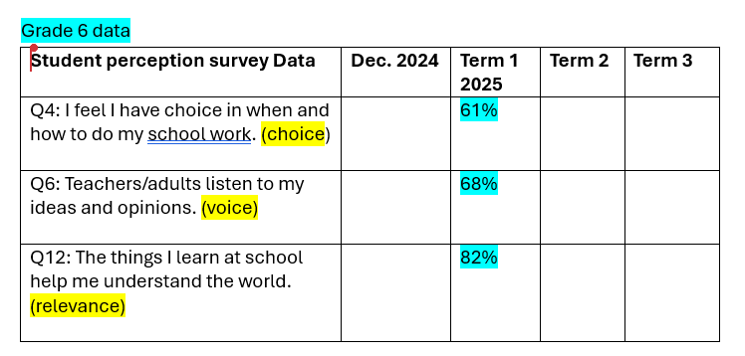
Progress monitoring – grade 6

Slide 21
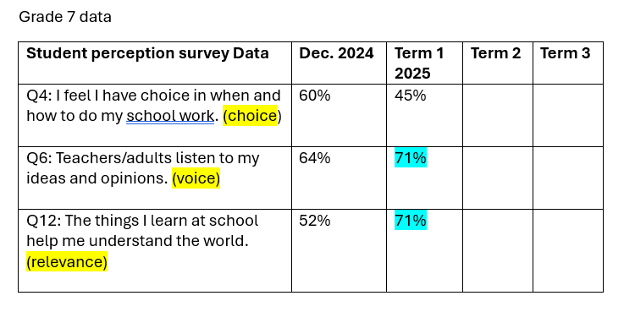
Progress monitoring – grade 7

Slide 22
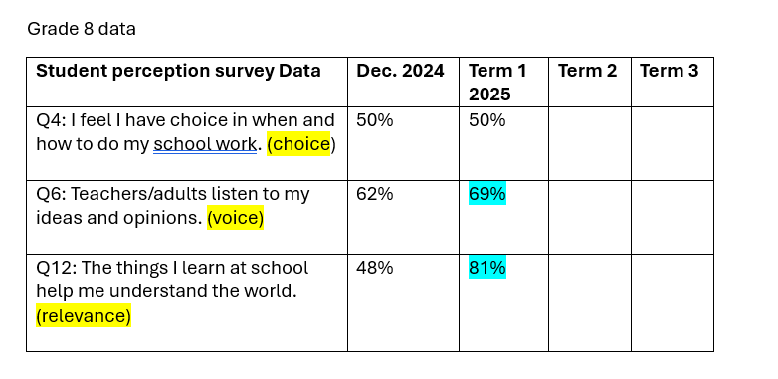
Progress monitoring – grade 8

Slide 23
Special events and Projects
ASD- West : Anti racism Pilot Project
5 schools invited to participate
1st meeting on Jan. 16th, Mrs. Smith represented PAMS at the meeting.
      PAMS
      Woodstock High
      Leo Hayes
      Fredericton High
      Devon Middle

Slide 24


Christmas BINGO – postponed due to weather

Slide 25
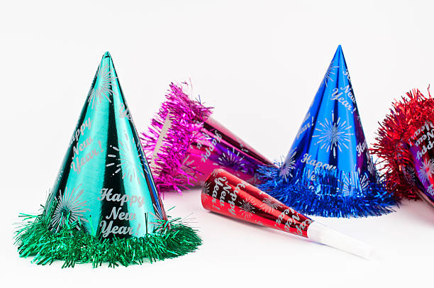
New Years Dance 2026
Jan. 8th 6-7:30pm
Spot dances
Limbo
Cha-cha slide
Just dance screen
Balloons
Prizes

Slide 26


Slide 27
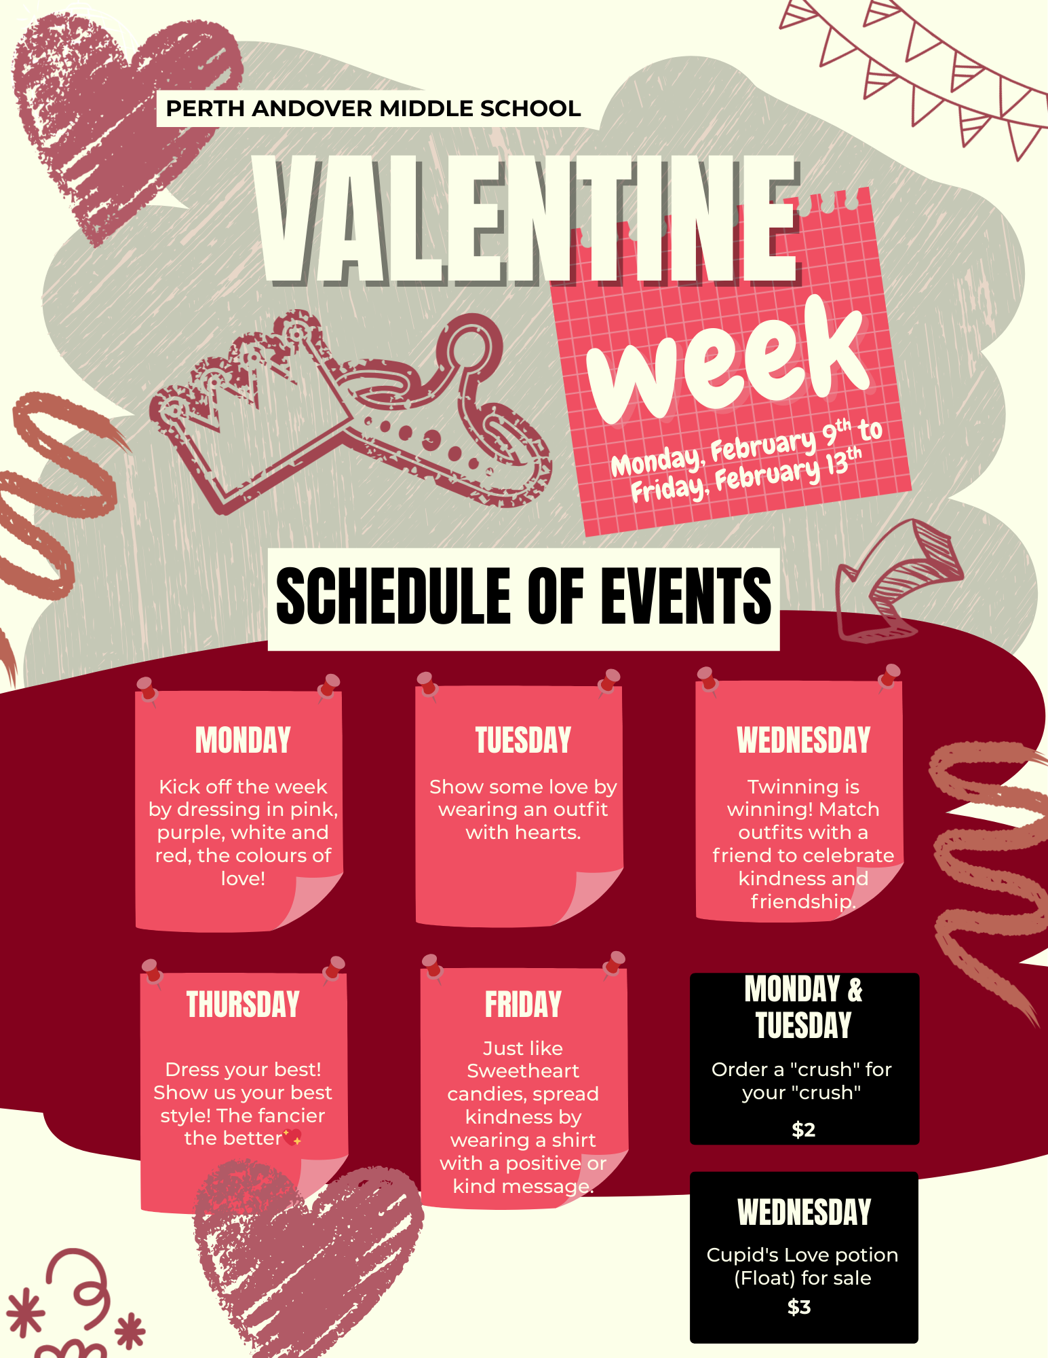
Theme week for Valentine’s week

Slide 28
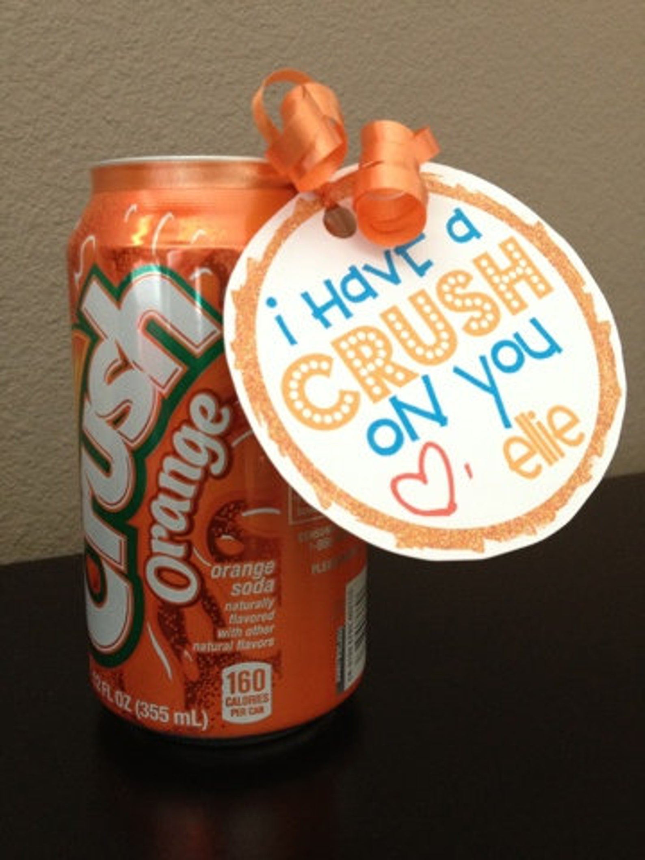

Sweet snacks for sale
Valentine’s week
Order a "crush" for your "crush" $2
Cupid's Love potion for sale - (Vanilla ice cream, Red crush, Whip cream, Pink sprinkles) $3

Slide 29

Staff Appreciation week
Snacks and surprises for staff throughout the week.
Home and School or staff volunteers

Slide 30
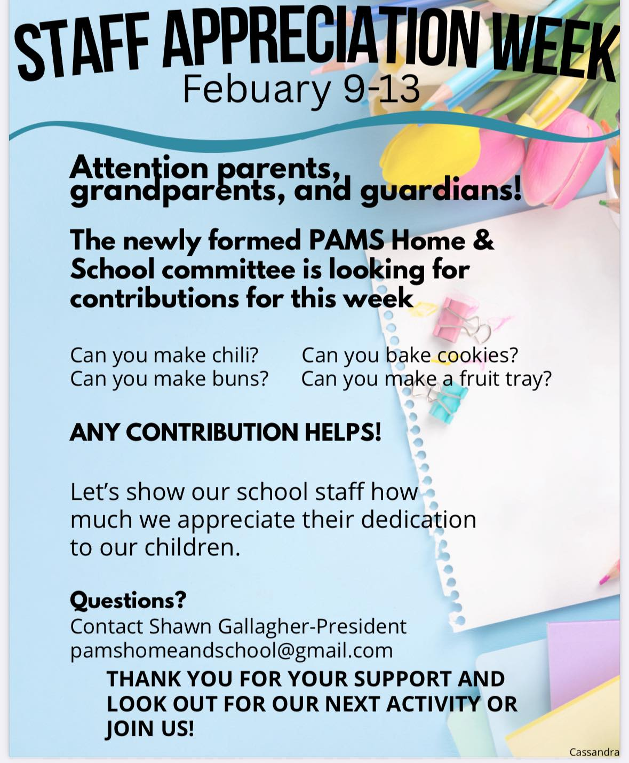

Slide 31

Pink Shirt day – Feb 25th
Kindness activities

Slide 32

Southern Victoria
Winter Freeze fest activity
Feb.26th 6:30-7:30pm.
Entrance is one full size candy bar or $2
Canteen & 50/50 draw
PAMS Cafeteria

Slide 33
Transitions grade 5 – tentative
Feb. 18th PBIS Sliding Party/ Fire/ Hot Chocolate
Feb 26 Chocolate bar Bingo
Mar. 12 AES & Mah-Sos visit for welcome activity.
Apr. 8th PAMS staff visits Mah-Sos and AES for Q and A
Apr. 30 Mah-Sos and AES visit PAMS for assembly and lunch
May 12 Gr 5 Students at PAMS for station activities and get to know you time
May 27 Mah-Sos join PAMS grade6
June - Parents open house

