Slide 1
Fall PSSC meeting #2 Dec. 8, 2025
Jenna Dyer - Chair
Jeremy Bosse – Vice Chair
Jessica Smith (teacher rep.) - Secretary
Setira Williams
Kathryn Mann
Jacki Ciesielski
Krista Sockabasin
Sophia Gallagher – DEC rep.
Claudine Grant (principal)
DEC and Principal are non members

Slide 2
AGENDA
New Business:
Principals list
Budget
Correspondence:
Closing Comments:
Date of Next Meetings:
Call to Order:
Approval of the Agenda:
Approval of the Minutes from Previous Meetings for June and November 2025:
Business Arising from the Minutes:
Declaration signing
Standing items
Principal’s report
SIP
Home and School update
DEC report
Upcoming events

Slide 3
Meeting norms
Begin and end meetings on time,
Turn off cell phones and other electronic devices,
Stick to the agenda, keeping on track and on topic,
Address the Chair one at a time,
Limit the number of times a person speaks on an issue,
Show empathy, patience, understanding, respect & cooperate with others,
Offer solutions,

Slide 4
Approval of minutes from June 11 and Nov. 4, 2025

Slide 5
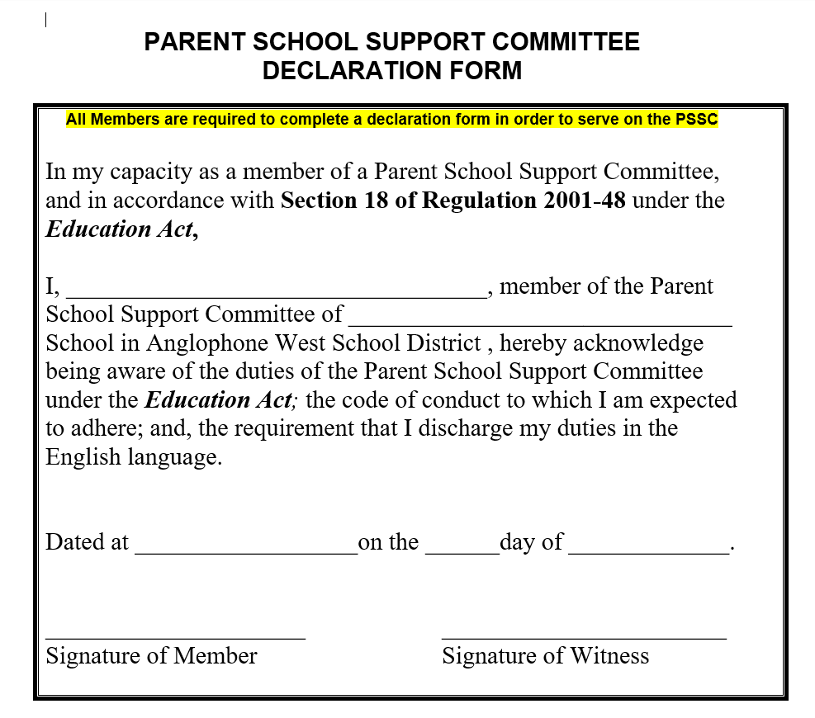
Business from Minutes :
Declaration form

Slide 6
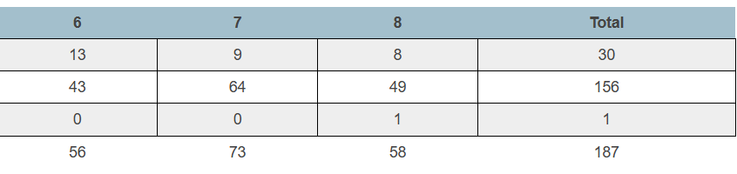
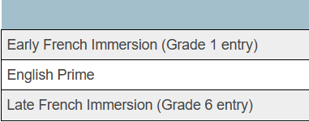
Principal’s report – PAMS student enrollment by program

Slide 7
PAMS – staffing update
Custodian change – Dawn Eccelston
BIM (behavior intervention mentor) – remains vacant, no suitable applicant
Kim Michaud – deferred leave begins Jan. 5th
Kayla Oakes – returns Jan. 26th

Slide 8
Long term recommendation 2.1 - Revitalizing Middle Block Philosophy
Purpose: To provide schools with practical tools and resources that support early adolescents
Focus Areas: Relationship – learner to learner
Learners actively listen and show respect to others, trying to understand different perspectives.
Strategies
Staff will co-construct what respect interactions - looks like / sound like / feels like (Jan. 6th , 2026)
Classroom connections time will focus on respectful interactions through group activities (Feb – June 2026)
School improvement connections : Prerequisite to the implementation of engaging learning strategies.

Slide 9
Long term recommendation 3.1
EECD Priority 3.1: Encouraging Movement –
Focus on Physical Activity and Wellness
Physical activity as a core component of student health.
Encouraging movement through daily routines and structured programs.
Promoting lifelong healthy habits and physical literacy.
Curriculum Integration
Experiential activities
Universal Design for Learning (UDL) principles to ensure inclusivity.
Broader Educational Priorities
The 2025 Education Priorities for New Brunswick include:
Improving student well-being
Reducing chronic absenteeism through engagement
Creating classroom environments that support physical & emotional health.
PAMS Champion for the application is Chantal Gallant

Slide 10
Youth Check-In Survey​
The YCI survey monitors student well-being and engagement three times a year, focusing on mental health, relevance, and relatedness.​
Participation Demographics​
Fall 2025 had 164 participants from Grades 6 to 8, with gender and First Nations cultural representation highlighted.​
Outcome Measurement Scale​
A six-point scale measures outcomes where 1–2 is low, 3–4middle, and 5–6 high to evaluate student feedback.
​
Data-Driven Support​
Collected data helps educators understand student perceptions to guide interventions and support.​
Youth Check In results – Fall 2025

Slide 11
Mental Health Status​
71% of students report good to excellent mental health, though 20% seek emotional support frequently (more than 4 times)​
School Relevance​
85% of students find their learning skills useful and74% feel cultural pride from school teachings.​
School Relatedness​
79% have supportive adults at school, yet only66% feel part of the community and 62% feel peer support.
Mental Health, School Relevance, and Relatedness

Slide 12
Staff reviews data – identify areas for growth ​
Next survey – Feb. 2026
Next Steps

Slide 13


School improvement Plan GOAL
GOAL : By June 2026, Perth Andover Middle School will improve behavioral engagement by creating a student-centered learning environment. 100% of teachers will intentionally incorporate the three learning styles in classroom instruction.

Slide 14
Update Indicators of success will include :
Increase in Engagement scores on Provincial Student Survey (December) and PAMS Survey Scores (November/March/June)
Q12: “What I learn helps me understand the world.”
Q20: “Learning connects to real-world problems.”
Q54: “I have choice in my schoolwork.”
Q6: “My teachers listen to my ideas.”
Increase Teacher Implementation of Personalized Strategies - scoreboard
Accountability partner / self reporting on SIP TEAM
Lesson plan / walkthroughs
Recognition of Student Effort
Monthly displays of student work in all classrooms or common areas.
Student feedback
Roar cards

Slide 15
SIP update – Nov. 10th PL
Our staff recently participated in a professional learning session focused on understanding and supporting different student learning styles. Explored Learning Styles: Teachers completed a learning style inventory and reviewed student learning styles. Shared Strategies: Staff collaborated to exchange effective classroom strategies and identified new approaches to try. Deep Dive: Each team researched one learning style in depth to strengthen their instructional practices. Action Planning: Teachers integrated new strategies into upcoming lesson plans and created an action plan with accountability partners to ensure continued growth. This work helps us tailor instruction so every student can thrive in their unique way.

Slide 16
SIP update – Half day PL -Dec. 5
Our staff continued their work on understanding and applying student learning styles in the classroom. Collaboration & Accountability: Staff met with accountability partners to review progress and share strategies. Strategy Sharing: Teachers uploaded new strategies they have tried into our shared platform and discussed additional approaches for different learning styles. Focused Planning: Teachers and support staff shared collaborated to plan for integrating new strategies into upcoming lessons. Educational Assistants: EAs reviewed the learning styles of their students and developed strategies to support them effectively.

Slide 17


Christmas BINGO

Slide 18
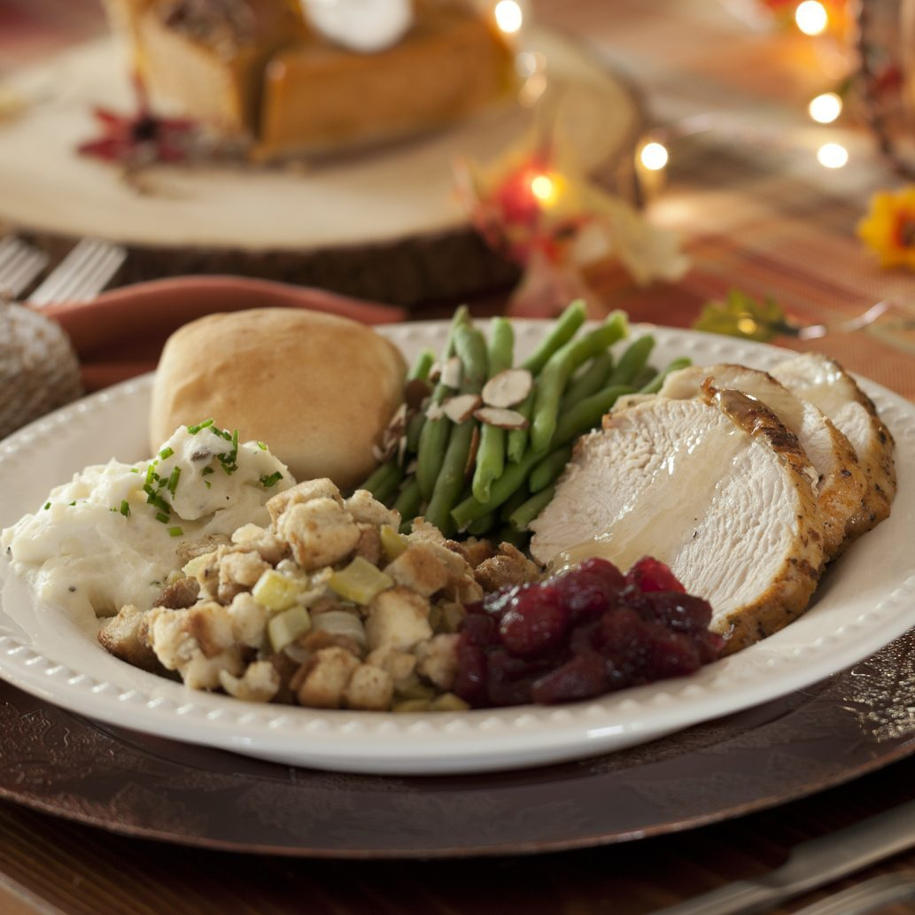
Free Christmas Dinner – Dec. 10th

Slide 19

Theme week

Slide 20

Academic Assembly

Slide 21


Honey and Poinsettias are still available

Slide 22

Principal’s list Dec. 2025
Bronze – 8 of less “3”
7 students
Silver – 5 or less “3”
15 students
Gold – no “3”
1 student

Slide 23

Princpal’s list
New Business

