Slide 1
Fall PSSC meeting Nov. 4, 2025
Jenna Dyer
Setira Williams
Jeremy Bosse
Kathryn Mann
Jacki Ciesielski
Krista Sockabasin
Jessica Smith (teacher rep.)
Sophia Gallagher – DEC rep.
Claudine Grant (principal)
DEC and Principal are non members

Slide 2
Principal’s Report:
Staff / Student 2025-26
School Improvement Plan focus
Student wellness survey – Dec. 2024
Sept. / Oct. events and projects – recap
New Business:
Honey Fundraiser
Breakfast program
Policy 407 – Community Use of Schools general explanation
Long term Recommendation 2.1(LTR)- Middle level learners
LTR 3.1 – Encouraging Movement
Date of Next Meeting: to be determined
Adjournment:
AGENDA
Call to Order
Approval of the Agenda
Business Related to the First Meeting:
Introduction – round table
Role of PSSC and member roles – review of PSSC manual
Nomination of Chair, Vice Chair and Secretary –
Meeting Norms –
Meeting dates determined –
Approval of the Minutes from Previous Meeting (June 11, 2025)
Business Arising from the Minutes

Slide 3
PSSC Members Role p.7
• Participate in all meetings
• Maintain high ethical standards and respect for other members,
• Respect the majority decision,
• Work collectively towards improving student learning
• Limit discussions to matters of the school as a whole
• Resolve issues in the best interest of all students and the whole school,
• Build a positive school environment and support open communication
• Encourage successful relationships and support between parents, teachers, students, staff and the community,
• Annually elect, or appoint by consensus, a chair, vice-chair and secretary

Slide 4
PSSC Chairperson Role p. 7
Sets the meeting dates, times, and agenda with the Principal and PSSC members
• Stimulates discussion by asking questions, encouraging quiet members to participate
• Keeps to the agenda with time limits for discussions if necessary
• Helps members reach consensus or calls for a vote if necessary
• Helps to resolve conflicts
• Ensures PSSC minutes are maintained and distributed.

Slide 5
Principal Role p. 7-8 (not a member)
• Ensures the establishment of PSSC
• Works with the PSSC Chair to set meeting agendas
• Seeks input and advice on areas related to PSSC responsibility
Coordinates advice given by the PSSC with input from school staff to make decisions in the best interest of all students to improve student learning
• Facilitates the operation of PSSC
• Acts as a resource on school legislation, regulations, policies, and collective agreements
• Provides school and district information
• Keeps a copy of minutes of each PSSC meeting
• Assists the PSSC in communicating with the school community

Slide 6
DEC Member Role p. 3 & 6
DECs: District Education Councils ensure that the Districts operate effectively and efficiently and reflect community desires and needs. They operate under a ‘policy governance’ model. DEC Councillors will attend PSSC meetings, according to internal policies, to establish the vital link between the DECs and the parents, guardians and the school community.
District Education Council Members: a member of the District Education Council may attend and participate in any PSSC meeting however, they do not have voting rights.

Slide 7
Out of scope p. 6
Teacher and Staff issues
Individual student behaviors or academic issues
Day-to-day operations
Fundraising

Slide 8

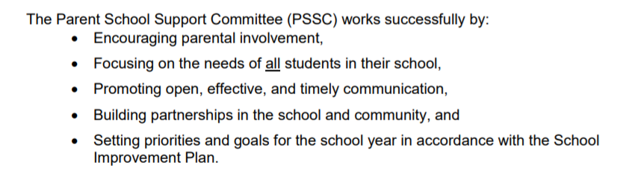

Slide 9
PSSC - Declaration of office
18Each member of a Parent School Support Committee shall subscribe to a declaration of office, on a form provided by the Minister, before conducting business as a member of the Parent School Support Committee to signify that the member is aware of
(a) the duties of the Parent School Support Committee under the Act,
(b) any code of conduct to which the member is expected to adhere, and
(c) the requirement that the member discharge their duties in the official language of the school district.
2021, c.10, s.2

Slide 10
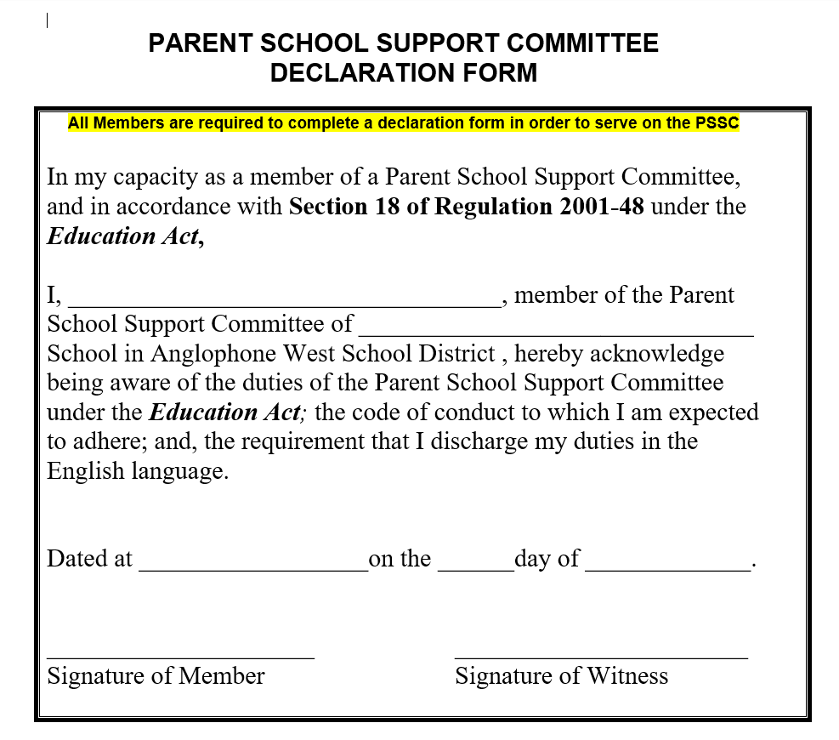

Slide 11
Election of officers
Chair
Vice Chair
Secretary

Slide 12
Meeting norms
Begin and end meetings on time,
Turn off cell phones and other electronic devices,
Stick to the agenda, keeping on track and on topic,
Address the Chair one at a time,
Limit the number of times a person speaks on an issue,
Show empathy, patience, understanding, respect & cooperate with others,
Offer solutions,

Slide 13
Meeting dates - Wednesdays?
November
December
February
April
May
June

Slide 14
Approval of minutes from June 11, 2025

Slide 15
Business from Minutes :
Gaga Pit moved to Spring
Parking

Slide 16
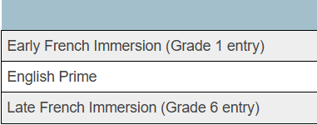
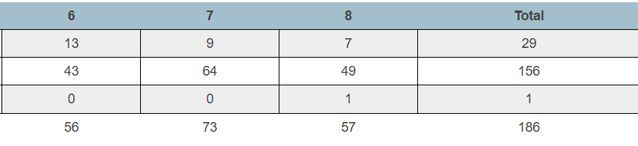
Principal’s report – PAMS student enrollment by program

Slide 17


Slide 18
PAMS
9 HR Classes
Teachers
Support Staff
15.5 Full time
Including
0.5 Educational Support teacher - counsellor
2.0 Resource teachers
1.0 Academic support teacher
1.0 Administration shared between Principal and Vice principal
2 custodians
1 administration assistant
2 grade 6
3 grade 7
2 grade 8
1 grade 6FI
1 grade 7/8FI
13 District Educational Assistants
3 First Nation Academic Support
1 First Nation Wholistic Behavior Intervention Mentor
1 School social worker 2days/week
2 –District Behavior intervention Mentor
(1 vacancy)

Slide 19

School improvement Plan GOAL
GOAL : By June 2026, Perth Andover Middle School will improve behavioral engagement by creating a student-centered learning environment. 100% of teachers will intentionally incorporate the three learning styles in classroom instruction. We aim to see a 10% increase in positive responses to items aligned with questions 6, 12, 20, and 54 of the 2024 provincial student survey. Progress will be monitored through in-house student surveys, administration walkthroughs, and teacher self-assessments following each reporting period.

Slide 20
Indicators of success will include :
Increase in Engagement scores on Provincial Student Survey (December) and PAMS Survey Scores (November/March/June)
Q12: “What I learn helps me understand the world.”
Q20: “Learning connects to real-world problems.”
Q54: “I have choice in my schoolwork.”
Q6: “My teachers listen to my ideas.”
Increase Teacher Implementation of Personalized Strategies - scoreboard
Self-reporting to teams
Lesson plan / walkthroughs
Recognition of Student Effort
Monthly displays of student work in all classrooms or common areas.
Student feedback
Roar cards

Slide 21
2024 NB Wellness survey key finding
Key Findings for Perth-Andover Area
Substance Use: Perth-Andover ranks among the highest areas in the province for substance use among students in grades 6–12.
21% of NB youth overall reported using one or more substances (alcohol, cannabis, vaping, cigarettes).
Perth-Andover, Douglas, and Salisbury areas had the highest rates of substance use compared to other communities.
Next steps – revisit during wellness expo in the Spring

Slide 22
2024 NB wellness survey key finding
Key Findings for Perth-Andover Area
Physical Activity & Screen Time:
Only 24% of NB students meet the recommended 60 minutes of daily physical activity.
Just 12% limit recreational screen time to two hours or less.
Perth-Andover follows the provincial trend of low physical activity and high screen time, though exact local percentages were not published.
Next steps – continue to expand our afterschool physical activities at no/low cost
continue to grow our playground

Slide 23
2024 NB wellness survey key finding
Key Findings for Perth-Andover Area
Sleep & Mental Fitness:
Many students are not meeting sleep guidelines, and mental fitness scores have declined province wide.
Anxiety and stress remain concerns, especially linked to screen time and lack of physical activity
Next steps – share sleep tips for parents in newsletter / wellness expo in the spring

Slide 24


Back to school Pancake Breakfast

Slide 25

Meet the teacher / Family Fun Night

Slide 26

School wide activity – Pumpkin Festival

Slide 27
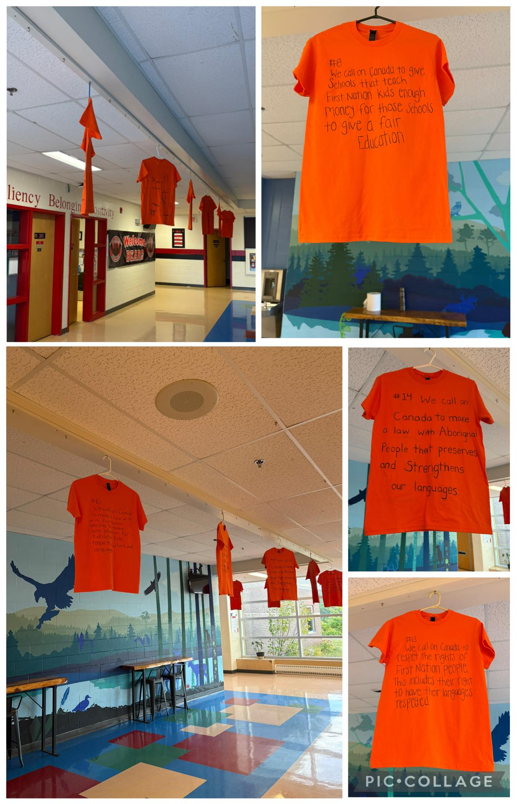
National Day for Truth and reconciliation

Slide 28



Slide 29

Safe Schools Week - physical & social/emotional safety

Slide 30

Spirit week

Slide 31

New Business

Slide 32
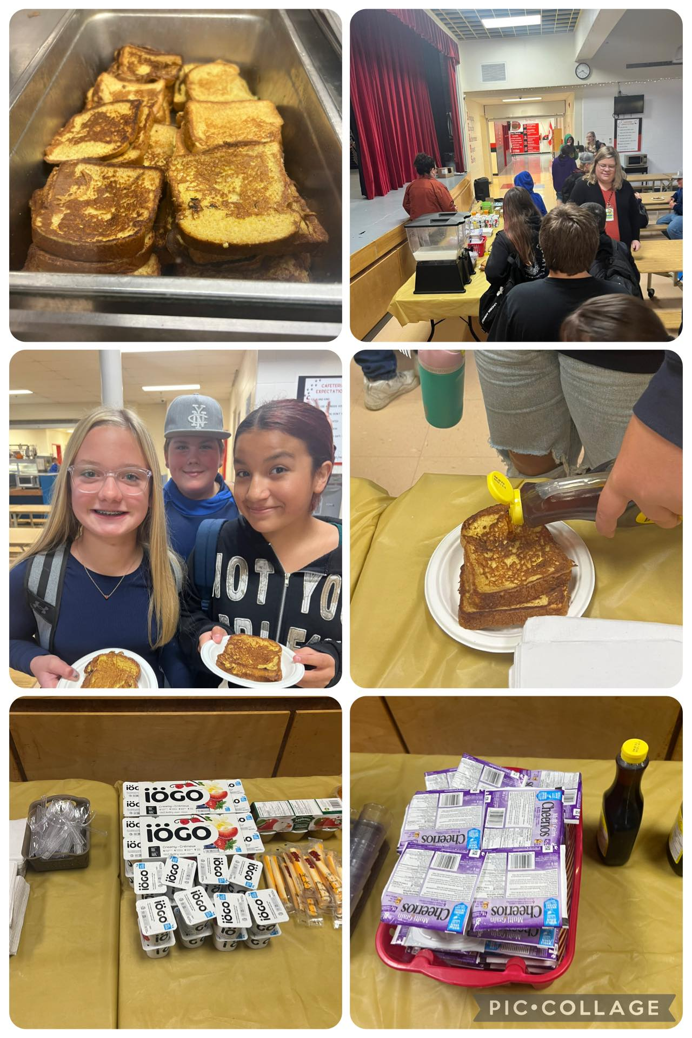
Breakfast Program
New Business
Call for volunteer – email / voice mail
3 hot breakfast with paid staff
Snacks in classes

Slide 33
Policy 407 – Community Use of Schools
Primary use of school facilities is the delivery of public education programs.
Schools will also be made available to the greater community with priority given to non-profit community activities for children and youth.
All inquiries and applications for use of school must be placed through the central booking software found on Anglophone West School District website.
Coordination and management of central booking software is completed through the Community Engagement – Operations team under the direction and guidance of the Superintendent or designate.

Slide 34
Long term recommendation 2.1
New Business
Revitalizing Middle Block Philosophy – Key Points
Purpose: To provide schools with practical tools and resources
that support early adolescents (ages 11–14).
Focus Areas:
Academic growth
Social-emotional development and belonging
Learning environment tailored
to developmental needs
Examples of Meaningful Learning:
Experiential learning through community partnerships
Hands-on opportunities that enrich student experiences
Structured support for students approaching or below curricular expectations
Next steps – committee will complete a middle school continuum assessment that addresses the focus areas.

Slide 35
Long term recommendation 3.1
New Business
EECD Priority 3.1: Encouraging Movement –
Focus on Physical Activity and Wellness
Physical activity as a core component of student health.
Encouraging movement through daily routines and structured programs.
Promoting lifelong healthy habits and physical literacy.
Curriculum Integration
Experiential activities
Universal Design for Learning (UDL) principles to ensure inclusivity.
Broader Educational Priorities
The 2025 Education Priorities for New Brunswick include:
Improving student well-being
Reducing chronic absenteeism through engagement
Creating classroom environments that support physical & emotional health.
PAMS Champion for the application is Chantal Gallant

